Slide 1
Crop prediction and Efficient fertilizer Recommendation using Machine Learning

Slide 2
Project Team
Team Members:
11716082 - Muktheswar Reddy B
11716090 - Sai Sahith Reddy M
11716097 - Swetha K
Under the Guidance of
Dr. P. Venakta Subba Reddy
HOD, Prof. Department of CSE
S.V.U college of engineering

Slide 3
Abstract
India has a large agricultural sector supporting majority of the population for their livelihood. It employees almost half of the India’s working class people. Every year huge resources in terms of land and fertilizer are used for production of food.
Most of the fertilizer being used in farms today is being wasted due to the incorrect use of type of fertilizer. We are developing a machine learning model that analyses various soil features like Calcium, Iron concentration ,pH of soil and various other features to recommend the type of fertilizer to use and also the type of crop needed for particular area for maximum benefit.

Slide 4
Introduction
The aim of this project is to take in features like annual rainfall, pH of soil , humidity, temperature of particular land area and train a machine learning model for accurate prediction of type of crop to be sown in order to get a good yield from crop. We also build a model to analyze soil features and recommend the type of fertilizer to be used.

Slide 5
Related Work
Niketa Gandhi et al ," Rice Crop Yield Forecasting of Tropical Wet and Dry Climatic Zone of India Using Data Mining Techniques",IEEE International Conference on Advances in Computer Applications (ICACA) , 2016.
Jharna Majumdar, Sneha Naraseeyappa and Shilpa Ankalaki, Analysis of agriculture data using data mining techniques: application of big data, Springer journal,2017.

Slide 6
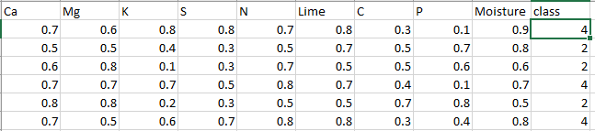
Proposed System Methodology
Data Set
The dataset used for fertilizer recommendation is soil features dataset. It contains various features of soil like Calcium concentration, Magnesium concentration etc. The dataset contains total of more than 16500 datapoints. It has 9 features.

Slide 7
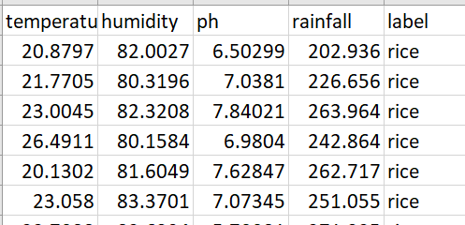
Proposed System Methodology
Data Set
The dataset used for crop recommendation is the land cover dataset which includes features such as temperature, annual rainfall, pH of the soil and humidity. It has a target variable indicating the suitable crop. The dataset has a total of more than 15000 datapoints.

Slide 8
Necessary Packages
Numpy
Pandas
Matplotlib.pyplot
Jupyter
Scikit-learn

Slide 9
Data Preprocessing
This process includes methods to remove any null values or infinite values which may affect the accuracy of the system. The values are also rescaled for faster training of the models. Steps in preprocessing include outlier detection, missing value treatment, rescaling. Cleaning process is used for removal or fixing of some missing data there may be data that are incomplete.

Slide 10
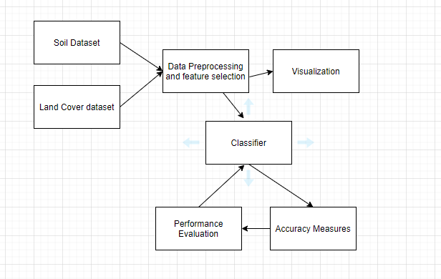
Architecture Diagram

Slide 11
Model Selection and Performance Evaluation
After feature selection the dataset is divided into pair of xtrain ,ytrain and xtest, y test. The algorithm model is imported form sklearn. Building model is done using model. Fit (xtrain, ytrain).
Crop type and fertilizer type are our output (target). Since we are going to classify using continuous features, we are going to implement using Decision tree regression, support vector regression and also neural network based classifier.

Slide 12
Model Selection and Performance Evaluation
After the model is build, prediction is done using model.predict(xtest). The accuracy is calculated using accuracy_score imported from metrics - metrics.accuracy_score (ytest, predicted).

Slide 13
Conclusion
We select the models with highest possible accuracy and the accuracy is measured with various metrics like K-fold, precision, recall. We intend to develop this model so that it is beneficial for farmers in decision making for good farm produce.

Slide 14
Thank You

